Slide 1
INDIAN
TRADITIONS, CULTURE & SOCIETY
G L B

Slide 2
OUTLINES
Module 5- Cultural Heritage and Performing Arts
Indian Architect, Engineering and Architecture in Ancient India, Sculptures, Seals, Coins, Pottery, Puppetry, Dance, Music, Theatre, Drama, Painting, Martial Arts traditions, Fairs and Festivals. Current development in Arts and Culture, India’s Cultural Contribution to the world. Indian Cinema

Slide 3
Architecture in India
Harappan Architecture
Earliest and best example of urban civic planning
Planned network of streets, homes and drainage systems.
Rectangular layout of buildings with precise angle measurements.
Elevated Citadel and lower half of the city constituted the two halves of cities.
Massive buildings with pillared halls, administrative buildings, royal and aristocratic mansions and courtyards.
Additionally air vents and elevated platforms were built to store grains.

Slide 4
Architecture in India
Mauryan Architecture
Around 4th century BCE
Mainly two categories: Court Art and Popular Art
Court Art: Palaces, Pillars and Stupas
Palaces: Main component was wood. Multistory structures with carvings and sculptures.
Pillars: they had inscriptions which served as governmental symbols.
Stupas: initially nine stupas were built following Buddha’s death. Each of them had relics of Buddha and served as the headquarters of the Buddhist traditions.

Slide 5
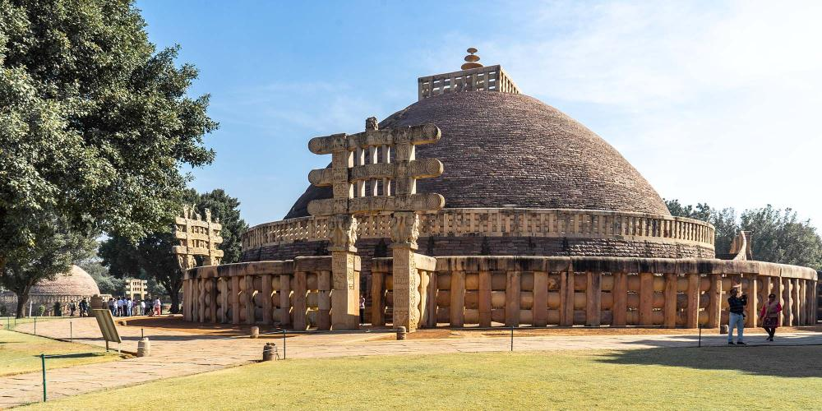
Buddhist Stupa, Sanchi (MP)

Slide 6
Architecture in India
Mauryan Architecture
Popular Art: Cave architecture and Pottery
Cave Architecture: Built in rock cut caves. Majorly used by Buddhist and Jain monks for their residence. They had proper ornate gates and polished interior walls.
Pottery: Northern Black Polished Ware was mainly used for pottery. Use of fine alluvial clay was also promoted in making polished products.

Slide 7
Architecture in India
Gupta Architecture
Golden period of Indian Architecture
Traditional in sense and perfectly executed in style and iconography.
Majorly related to Caves and Temple architecture
Caves: Finest example were Ajanta and Ellora caves
Ajanta caves: Aurangabad district of Maharashtra. Total 29 in numbers out of which 25 were used as residential and 4 were prayer halls of Buddhist monks.
Ellora Caves: Total 34 caves out of which 29 were Buddhist style and 5 followed Jain style. Theme and architecture wise more significant than Ajanta caves.

Slide 8
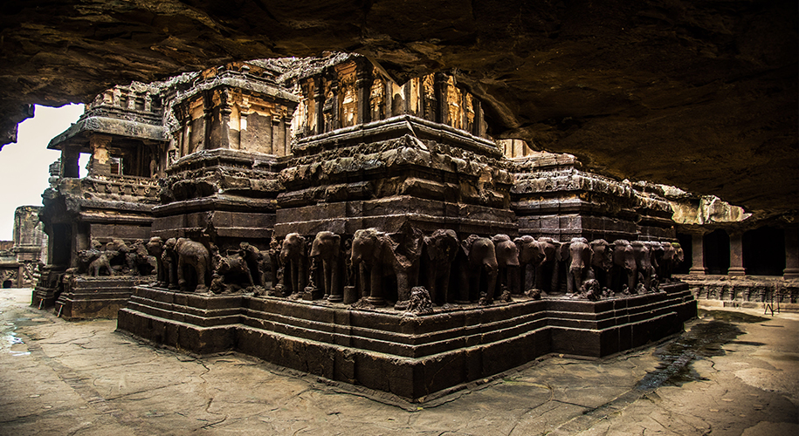
Architecture in India
Ajanta Caves, Maharashtra

Slide 9
Architecture in India
Temple Architecture
Most of the architectural remains that survive from Ancient and Medieval India are religious in nature. In different parts of the country, distinct architectural style of temples was result of geographical, ethnic and historical diversities.
Two broad orders of temples in the country are known as Nagara in the north and Dravida in the south. At times, the Vesara style of temples is also found as an independent style, created through the selective mixing of the Nagara and Dravida orders.
Nagara: Majorly in Northern India (Between Himalayas and Vindhya Mountains)
Design includes two major buildings: main shrine (taller) and mandapa (shorter)
Major features include its planning and elevation.
Plan is square in shape with a number of gradual projections in middle of each side which imparts its cruciform shape. Originally there were no pillars in Nagara style.

Slide 10
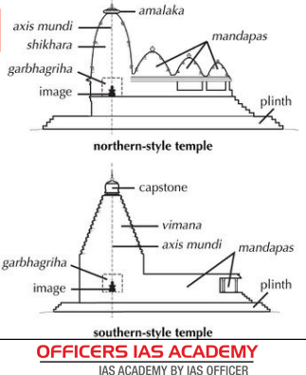
Temple Architecture of India

Slide 11
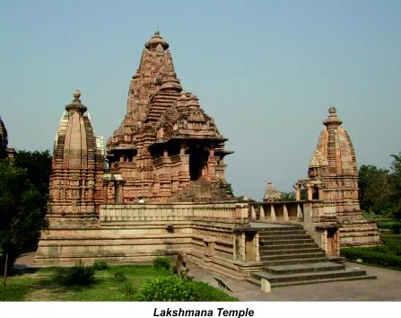
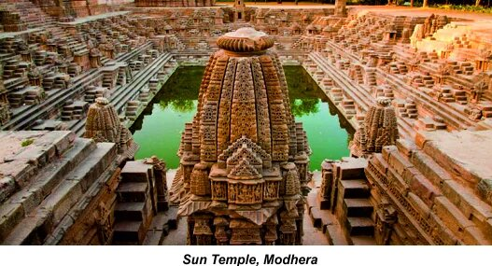
Lakshmana temple of Khajuraho, dedicated to Lord Vishnu, was built in 954 by the Chandela dynasty. It is a nagara temple placed on a high platform accessed by stairs.
Sun temple at Modhera dates back to the early 11th century and was built by the Solanki Dynasty in 1026. There is a massive rectangular stepped tank called the surya kund in front of it, perhaps the grandest temple tank in India. Every year, at the time of the equinoxes, the sun shines directly into this central shrine of the temple.

Slide 12
Temple Architecture
Nagara style temple: Some other prominent examples of Nagara temples includes
(i) Sri Ram Temple, Ayodhya
(ii) Sun Temple, Konark
(iii) Jaggannath Temple, Puri
(iv) Kamakhya Temple, Assam

Slide 13
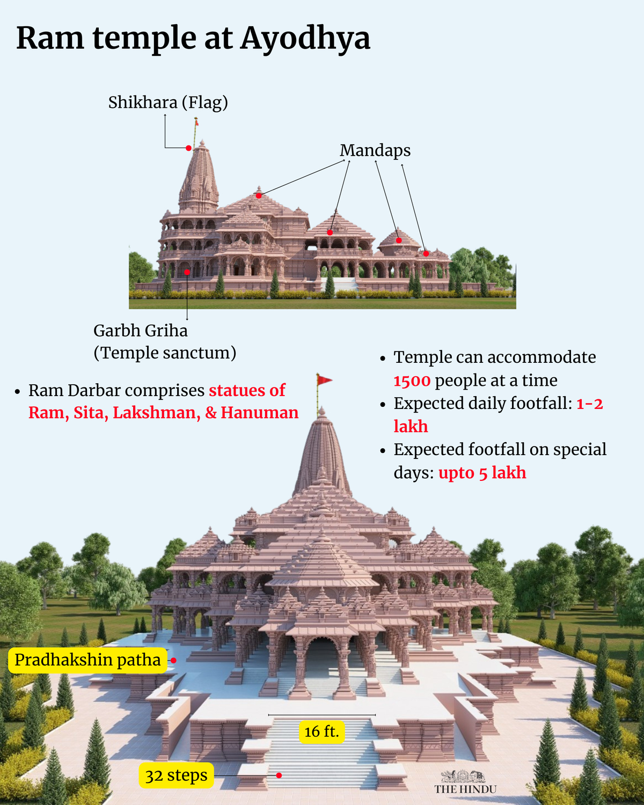

Slide 14
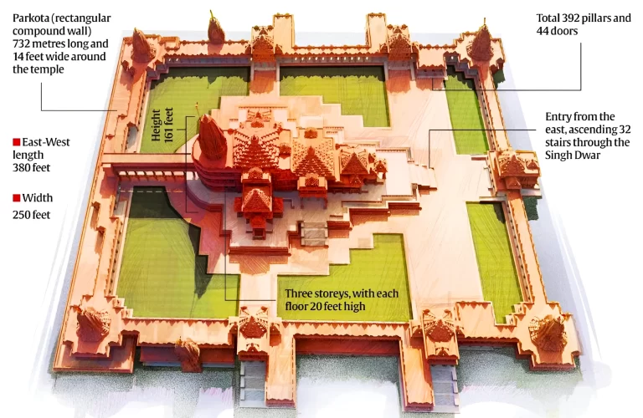
Plan of Sri Ram Temple, Ayodhya

Slide 15
Sri Ram Temple Key Points:
The Temple is built over three 20-foot high floors each with a total of 392 pillars and 44 doors.
Makrana Marble and Pink sandstone, granite stone and colored Marble are used in the construction.
Foundation of the temple is built of a 14-metre-thick layer of roller-compacted concrete and a 21-foot-high granite plinth has been placed to protect against ground moisture.
Iron has not been used anywhere in the construction.
The Architectural style of the temple is Nagara style with Sanctum Sanctorum (garbhagriha), Mandaps (halls), and Mandirs.
At each corner of the compound will be dedicated to Surya, Bhagwati, Ganesh, Shiva. On the northern and southern arms, temples to Annapurna and Lord Hanuman will be built respectively.
Temples of Maharshi Valmiki, Vashishtha, Vishwamitra, Agastya, Nishad Raj, Shabri etc. have also been proposed.

Slide 16
Dravida Temples:
Majorly developed under the Chola Dynasty (9th – 12th century AD).
Unlike the nagara temple, the dravidian temple is enclosed within a compound wall.
The front wall has an entrance gateway in its centre which is known as a gopuram.
The shape of the main temple tower known as vimana in Tamil Nadu, is like a stepped pyramid that rises up geometrically rather than the curving shikhara of North India.
It is common to find a large water reservoir, or a temple tank, enclosed within the complex.
Subsidiary shrines are either incorporated within the main temple tower, or located as distinct, separate small shrines beside the main temple.
Kanchipuram, Thanjavur or Tanjore, Madurai and Kumbakonam are the most famous temple towns of Tamil Nadu, where, during the 8th-12th centuries, the role of the temple was not limited to religious matters alone.
Temples became rich administrative centres, controlling vast areas of land.

Slide 17
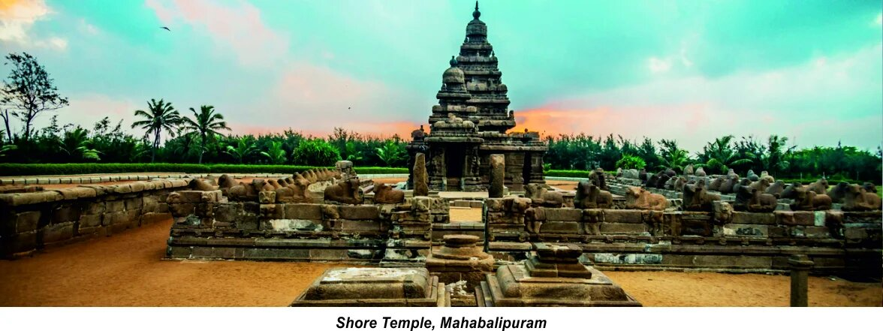
Mahabalipuram Temple, Chennai houses three shrines, two to Shiva, one facing east and the other west, and a middle one to Vishnu. Early buildings, it is generally assumed, were rock cut, while the later ones were structural.
The early buildings are generally attributed to the reign of Mahendravarman I, a contemporary of the Chalukyan king, Pulakesin II of Karnataka.
Narasimhavarman I, also known as Mamalla, inaugurated most of the building works at Mahabalipuram which came to be known after him as Mamallapuram.
The shore temple at Mahabalipuram was built later, probably in the reign of Narasimhavarman II, also known as Rajasimha who reigned from 700 to 728 CE.

Slide 18
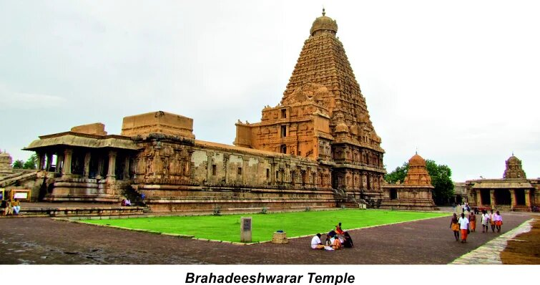
The Shiva temple of Thanjavur, called the Rajarajeswara or Brahadeeshwarar temple, was completed around 1009 by Rajaraja Chola, and is the largest and tallest of all Indian temples.

Slide 19
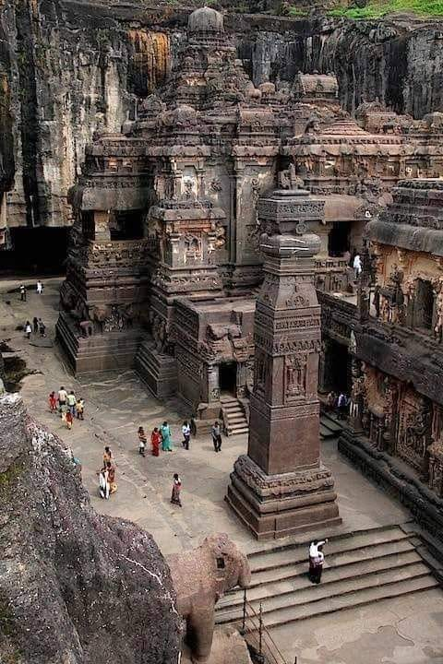
Many different styles of temple architecture influenced by both North and South Indian temples were used in regions like Karnataka.
By about 750 CE, the early western Chalukya control of the Deccan was taken by the Rashtrakutas.
Their greatest achievement in architecture is the Kailashnath temple at Ellora, a culmination of at least a millennium-long tradition in rock-cut architecture in India.
It is a complete Dravidian building with a Nandi shrine—since the temple is dedicated to Shiva—a gopuram-like gateway, surrounding cloisters, subsidiary shrines, staircases and an imposing tower or vimana rising to thirty metres.
Importantly, all of this is carved out of living rock. One portion of the monolithic hill was carved patiently to build the Kailashnath temple.

